Slide 1
Engineering Presentation
By Sagar Garg

Slide 2
Courses
Introduction to Engineering Design I
Digital Electronics
Engineering Technology
Introduction to Engineering Design II
Principles of Engineering
Manufacture Process CIM
Intermediate Electrical Engineering

Slide 3
Introduction to Engineering Design I
AutoDesk Inventor 2D skills
AutoDesk Inventor 3D skills
Designing Lego Figures
Final Year Project

Slide 4
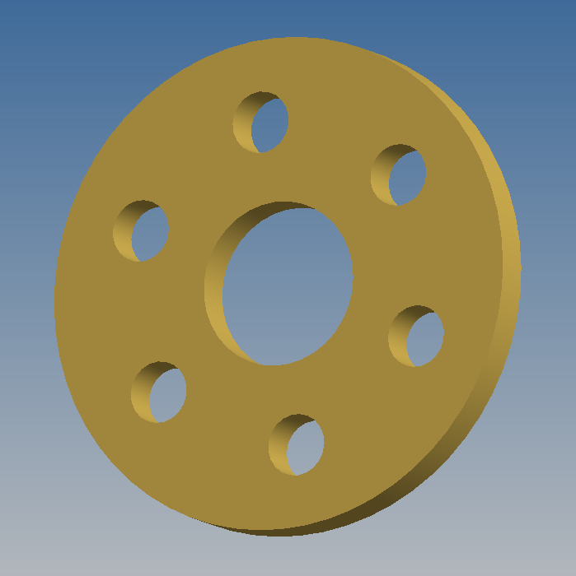
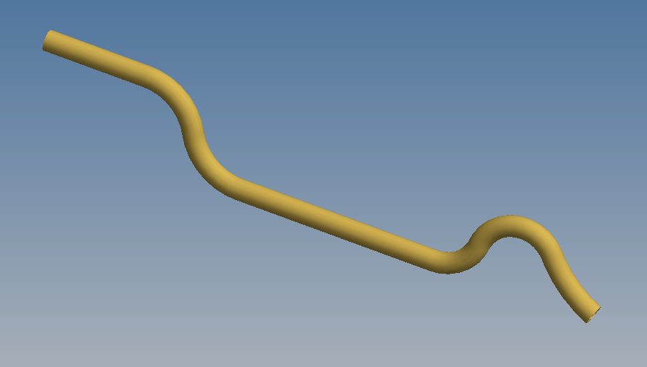
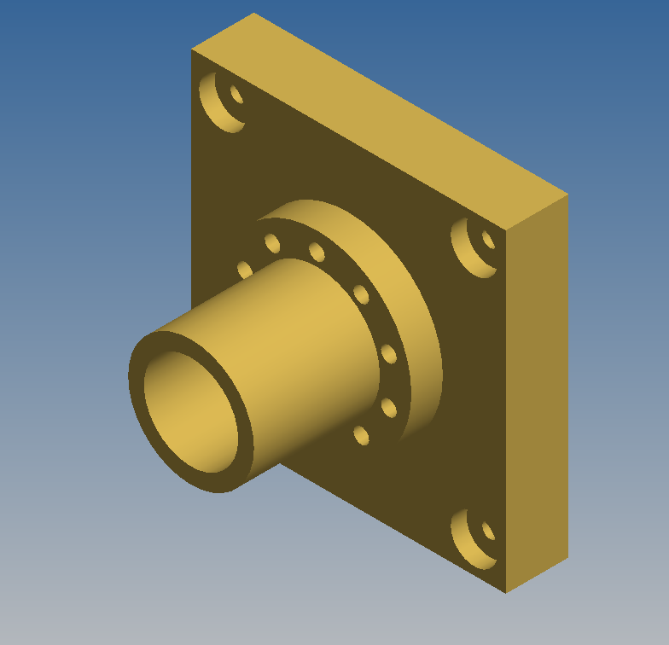
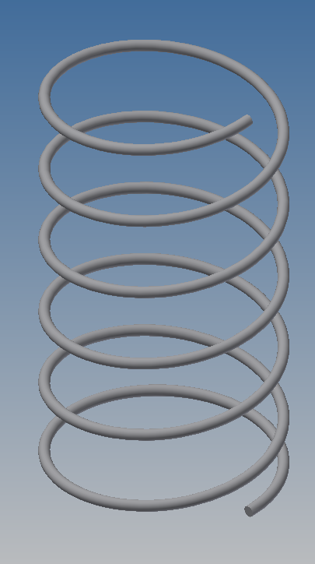
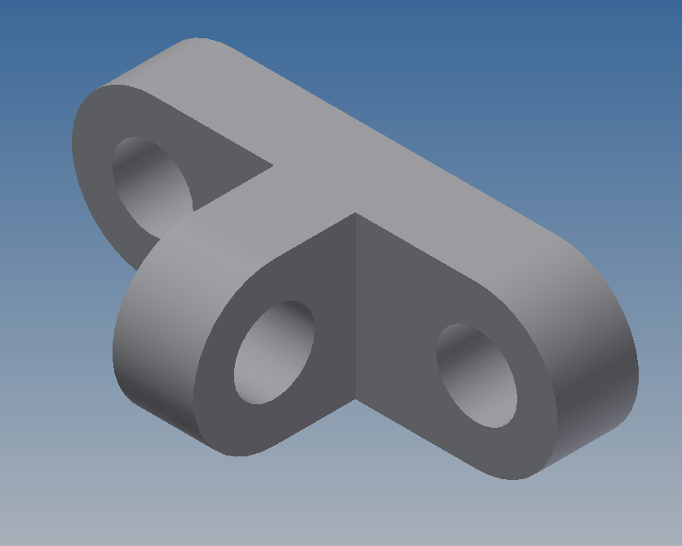
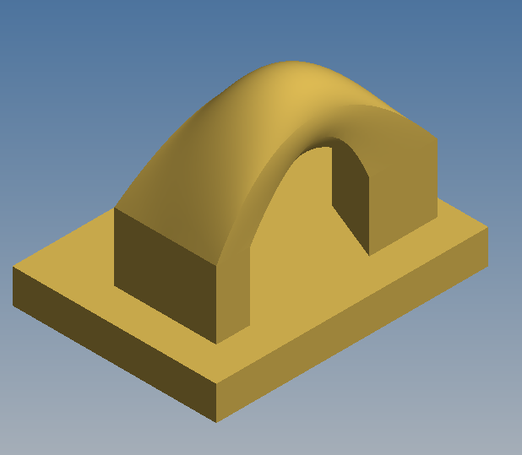
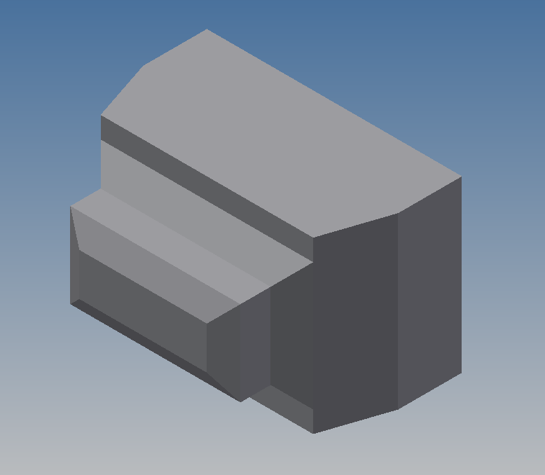
AutoDesk Inventor 2D and 3D skills

Slide 5
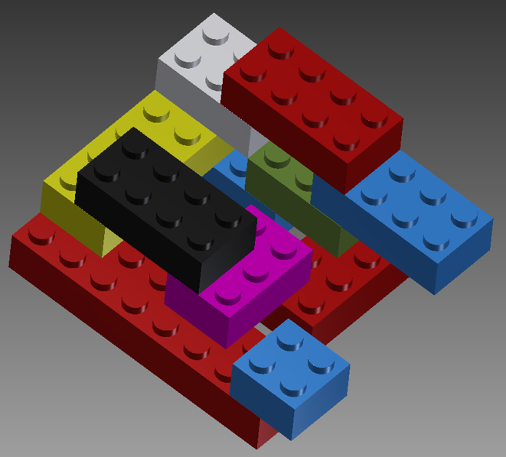
Lego Design
Learned how to create 3D designs
Learned how to constrain parts
Created an assembly and animation

Slide 6
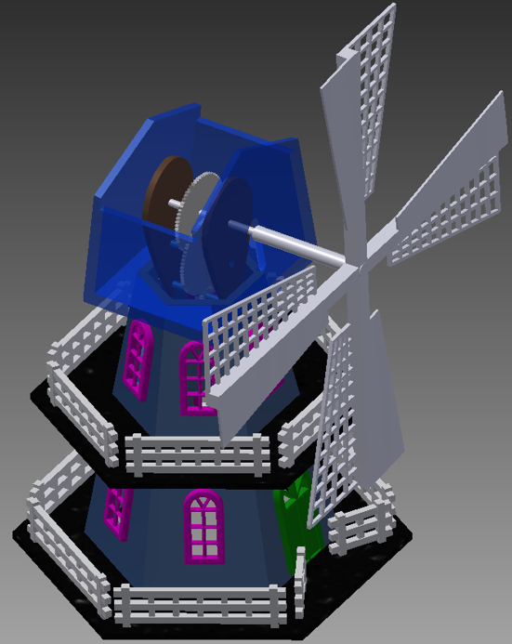
Final Year Project
Design a windmill
Created an Assembly and Animation

Slide 7
Digital Electronics
Learned basic electronics
Breadboard circuitry
Soldering
Christmas Tree Project

Slide 8
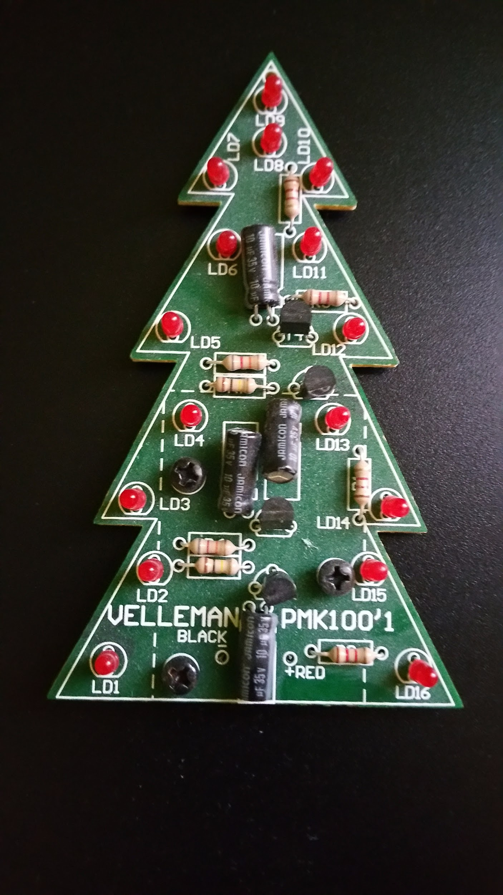
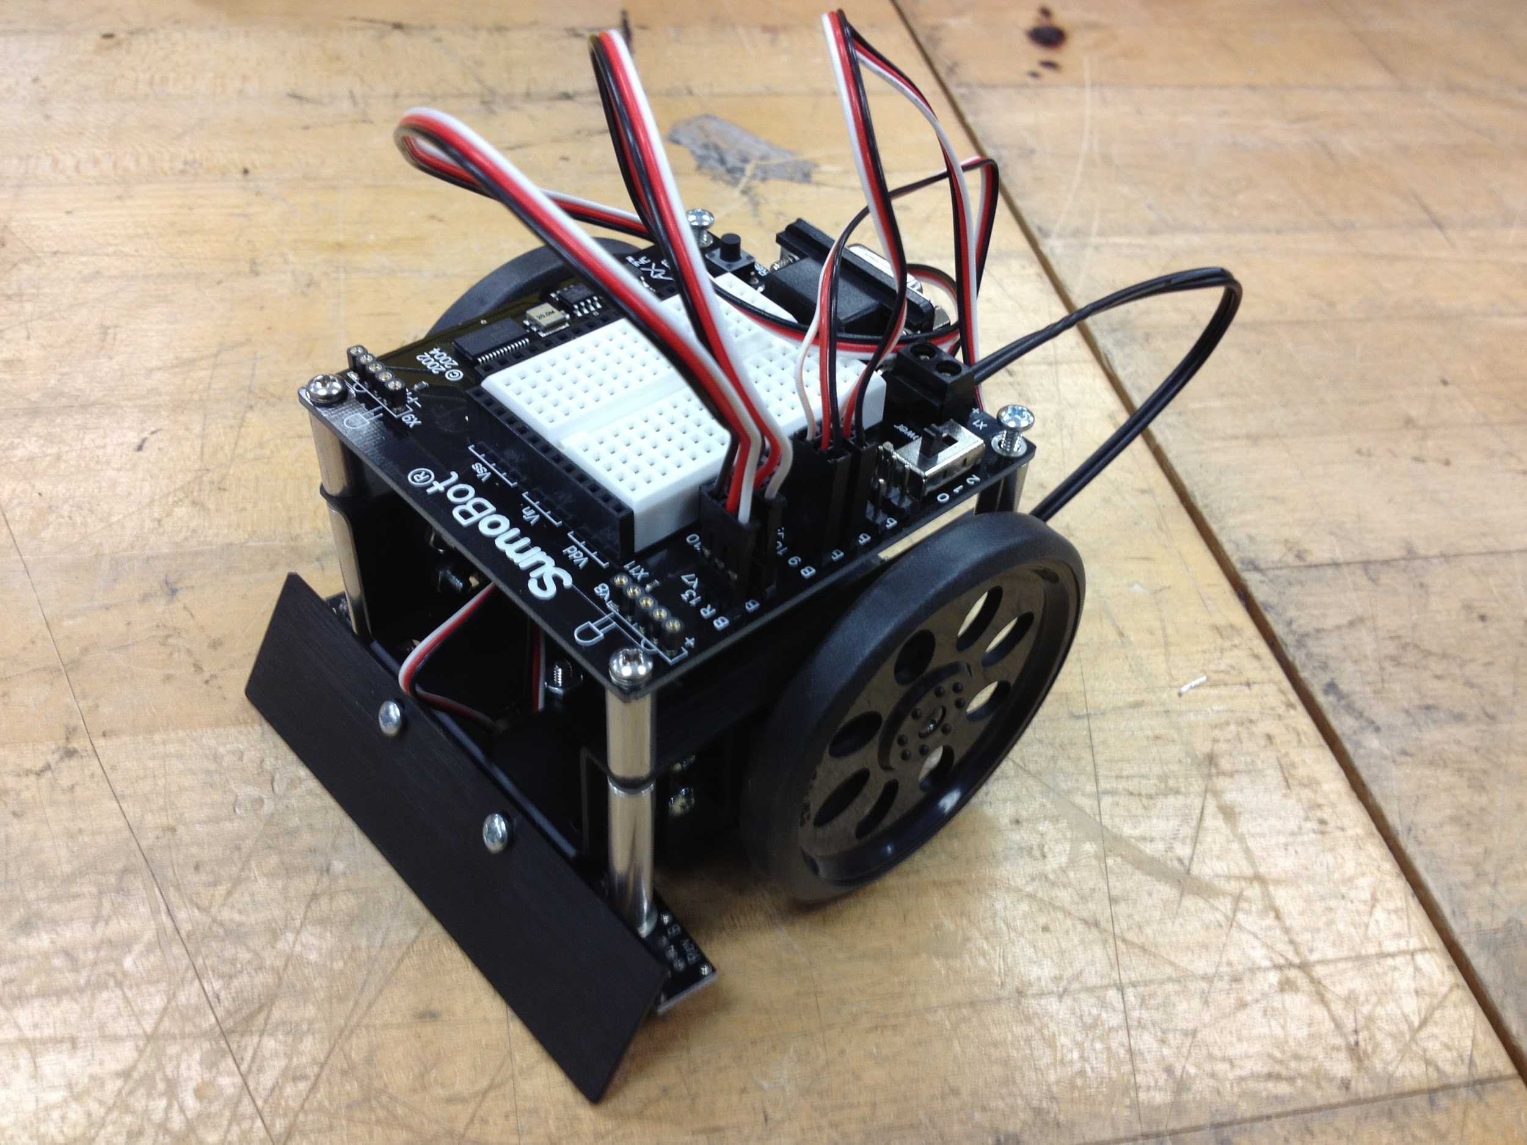
Digital Electronics
Christmas tree project - Learned to Solder on a circuit board
Breadboard arduino servo project

Slide 9
Engineering Technology
History of Computers
Various parts of a computer
Networking
Engineering Safety
Laser Printing
Robotics Engineering Project

Slide 10
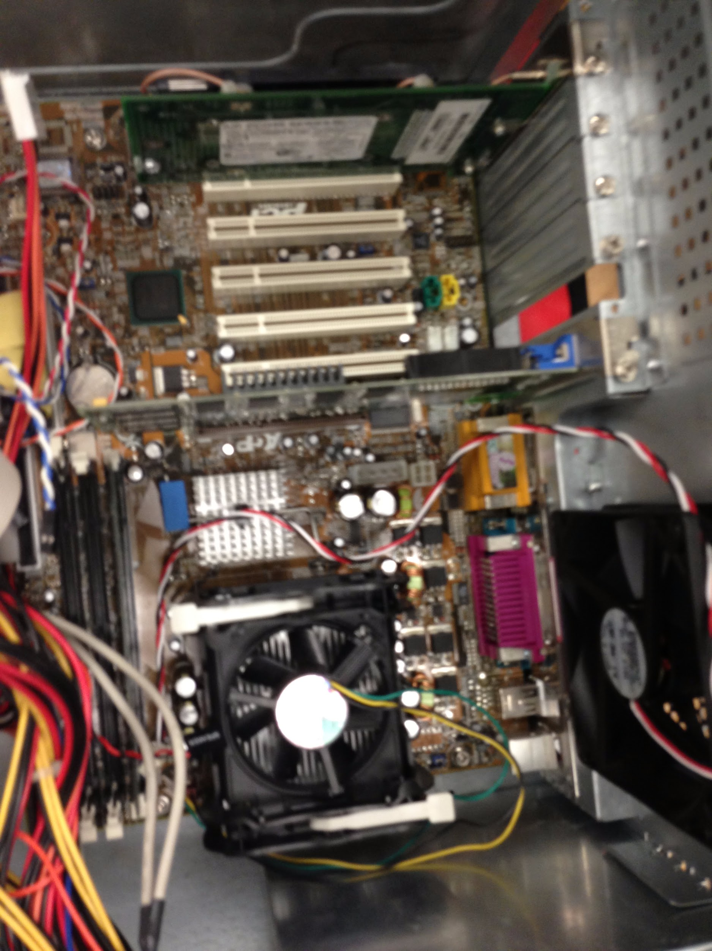
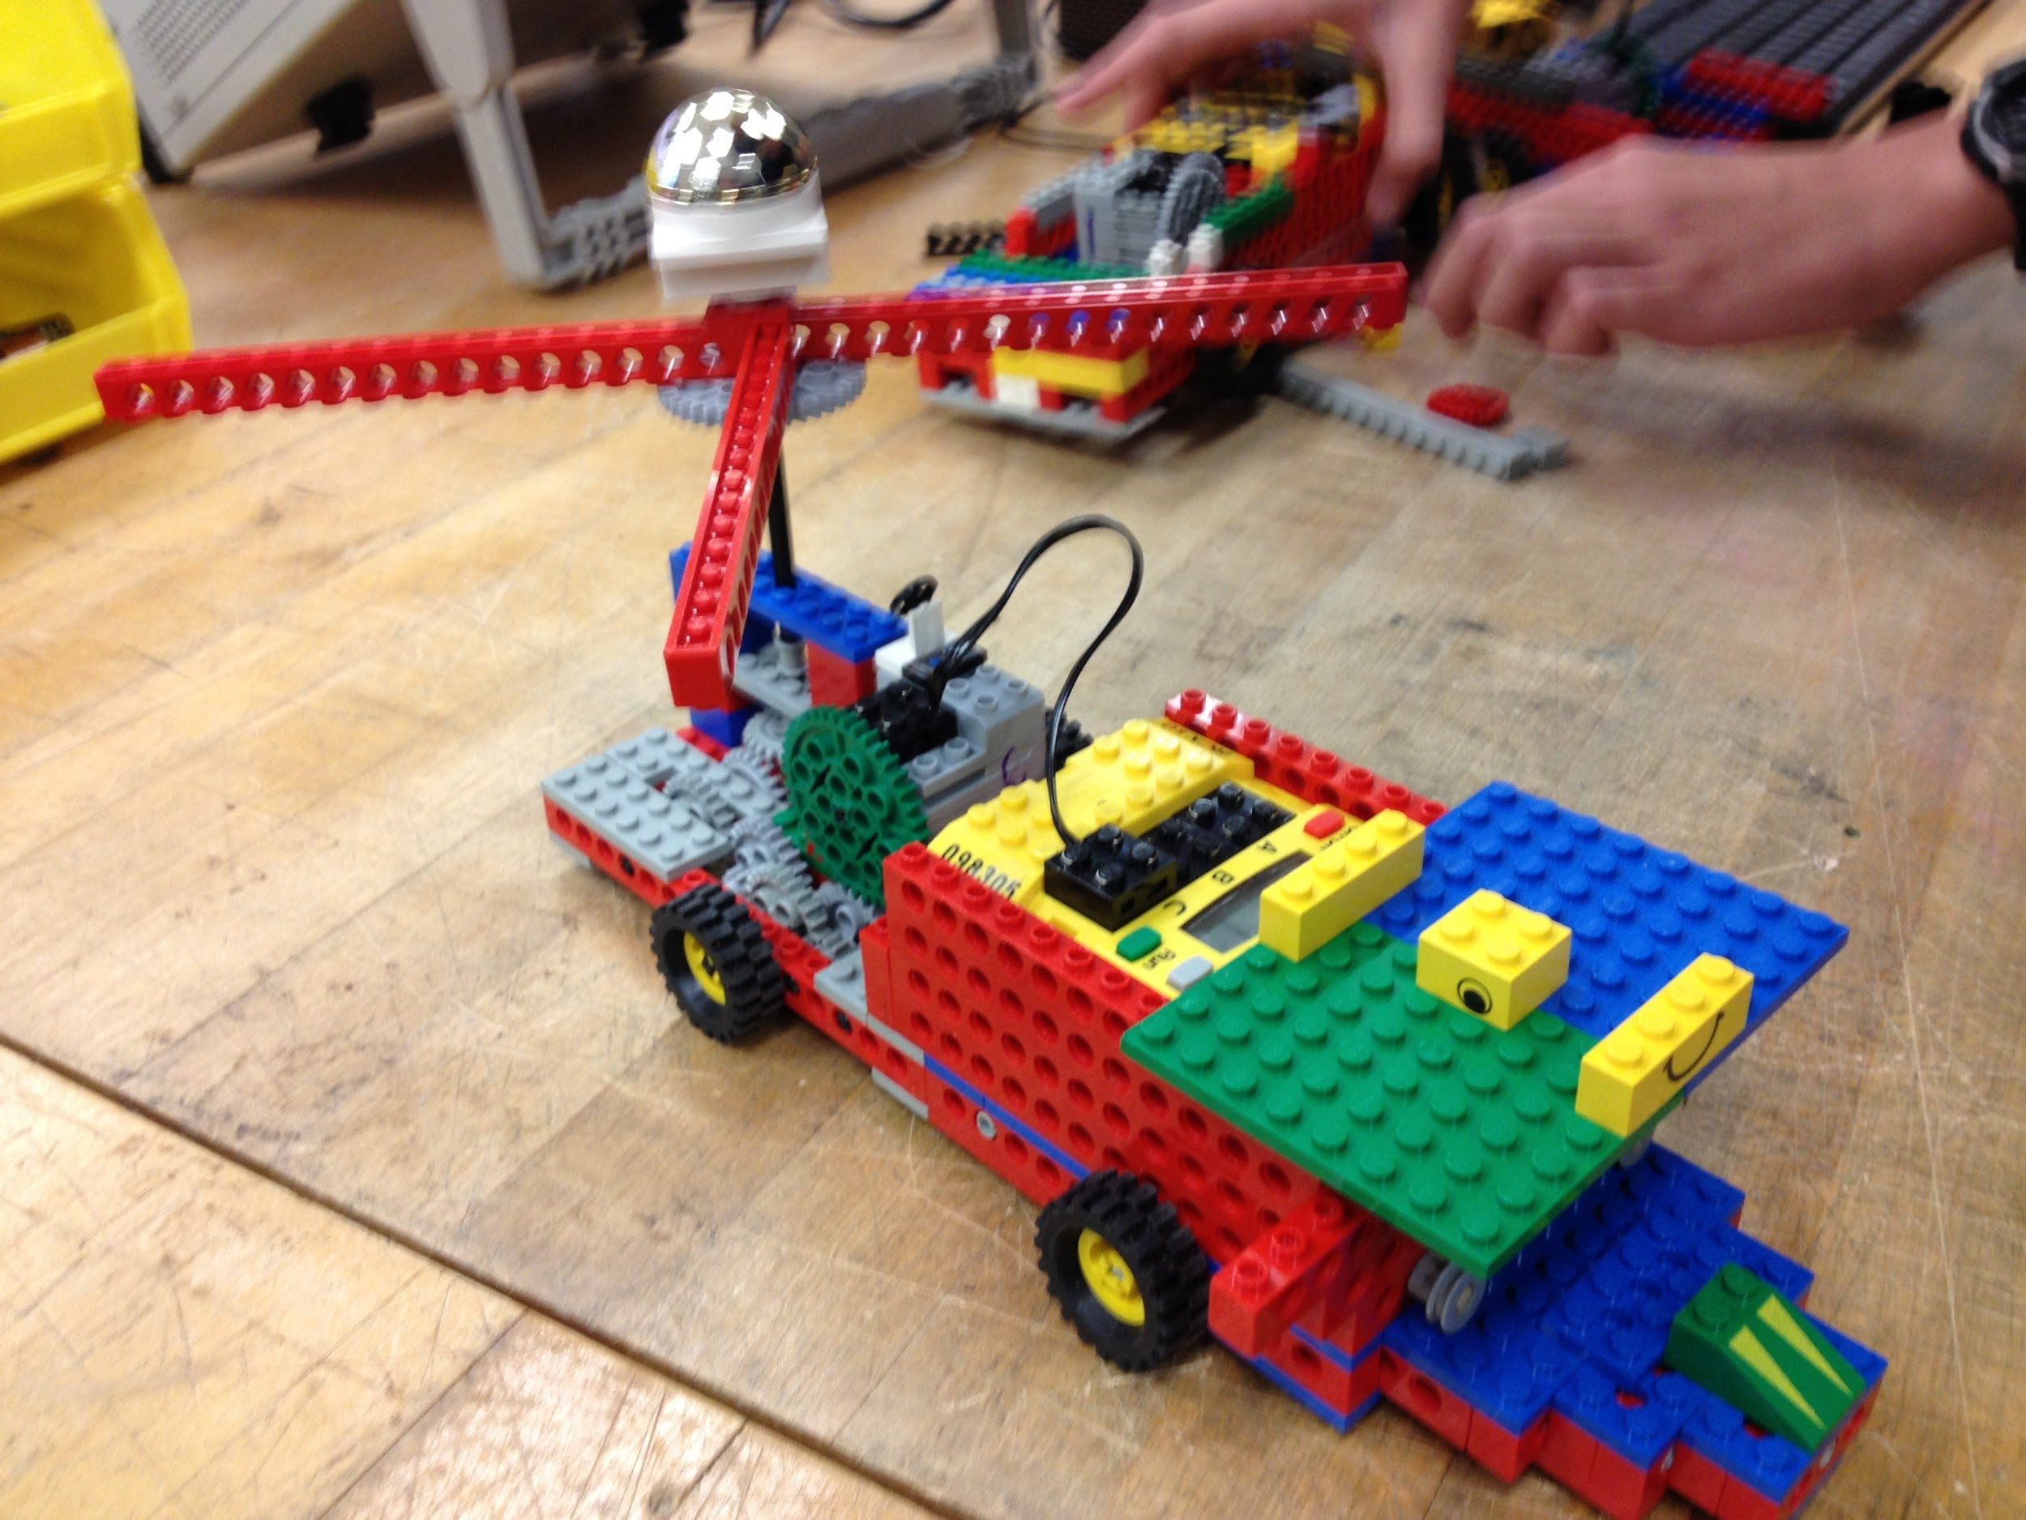
Engineering Technology
Deconstructed computer to identify different parts
Constructed a remote control robot similar

Slide 11
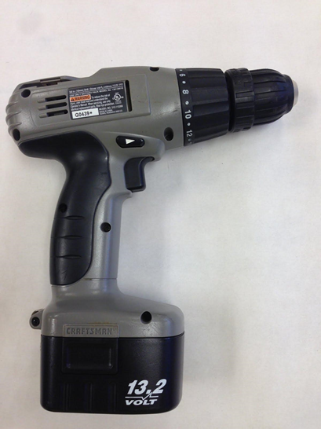
Introduction to Engineering Design II
Reverse Engineering Project
Electric Drill

Slide 12
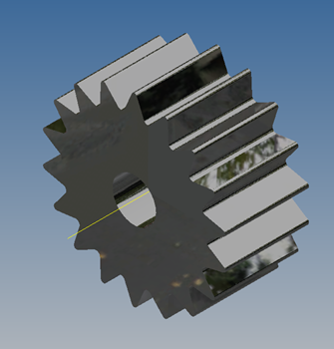
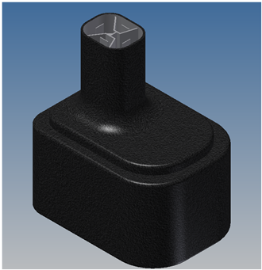
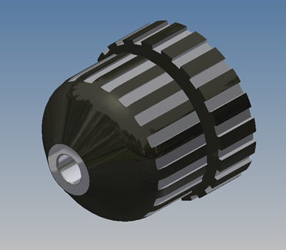
Major Parts

Slide 13
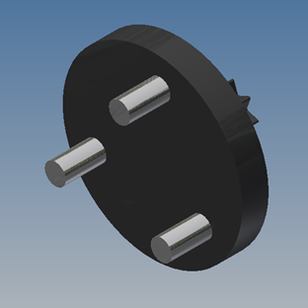
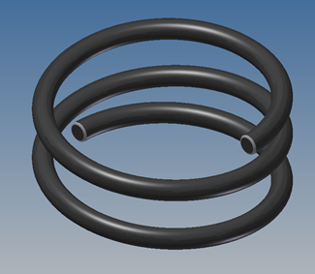
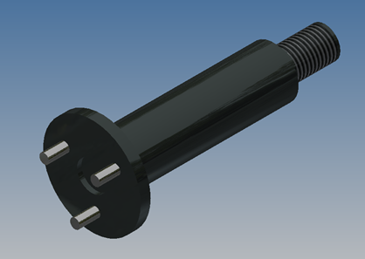
Major Parts

Slide 14
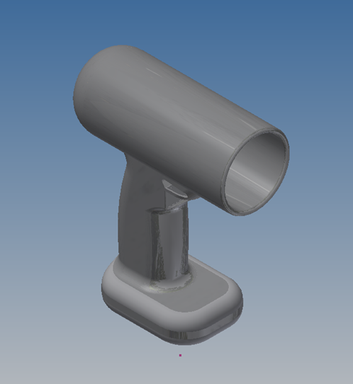
Major Parts

Slide 15
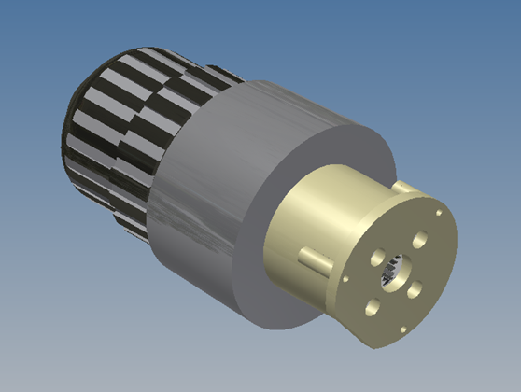
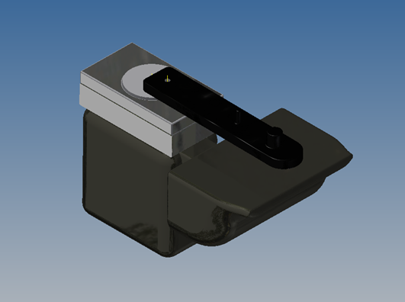
Assemblies

Slide 16
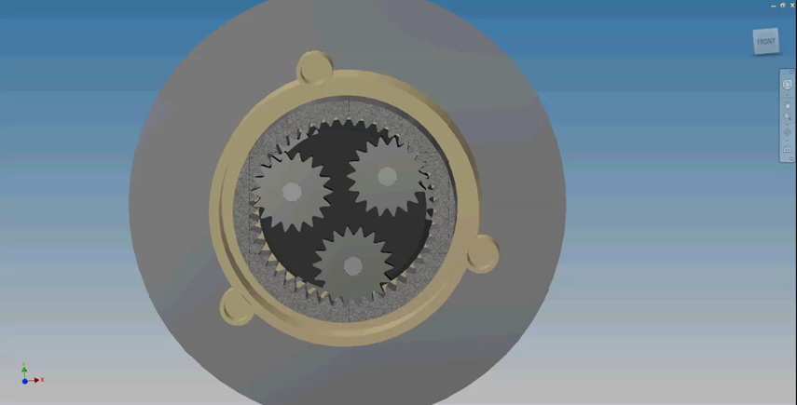
Gear Assembly

Slide 17
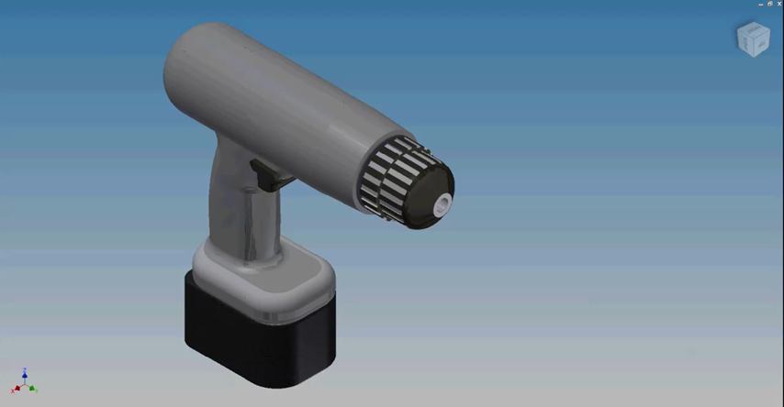
Final Project

Slide 18
Principle of Engineering
Bridge Truss Problems
Stress and Strain
Bridge Project
Tensile Strength Project
Started Arduino Programming

Slide 19
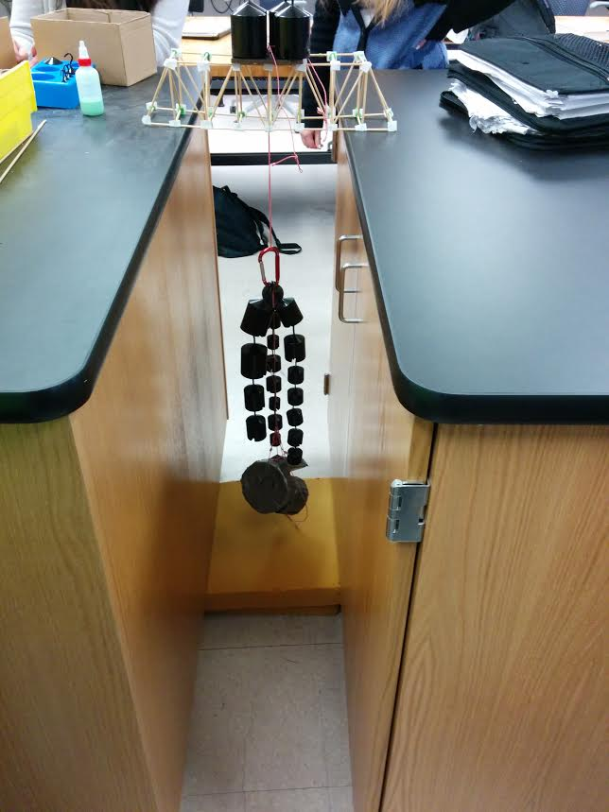
Principle of Engineering
Bridge Truss
Tensile Strength

Slide 20
Manufacturing Process CIM
AutoCad
CNC
Extreme Redesign
Water Jet

Slide 21
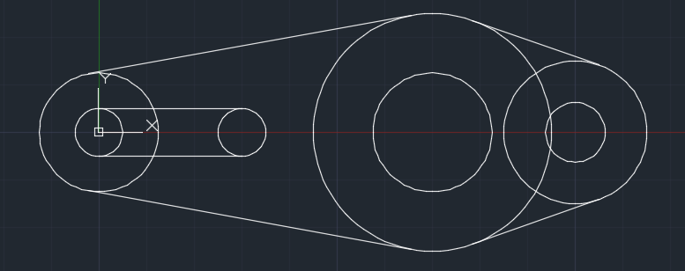
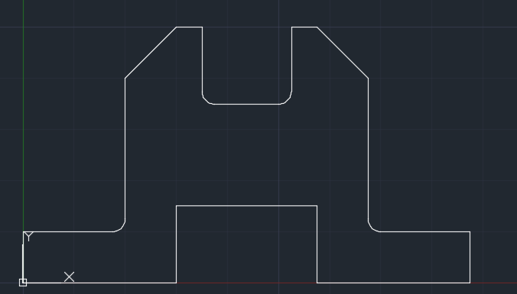
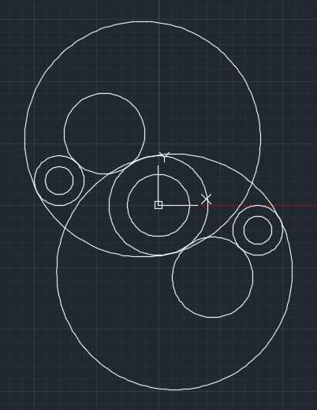
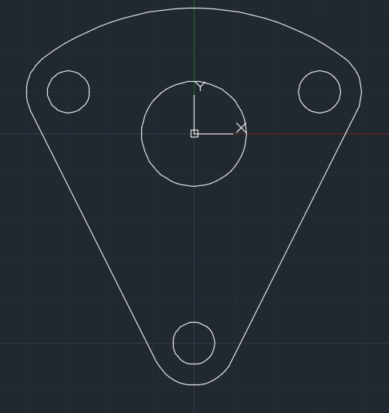
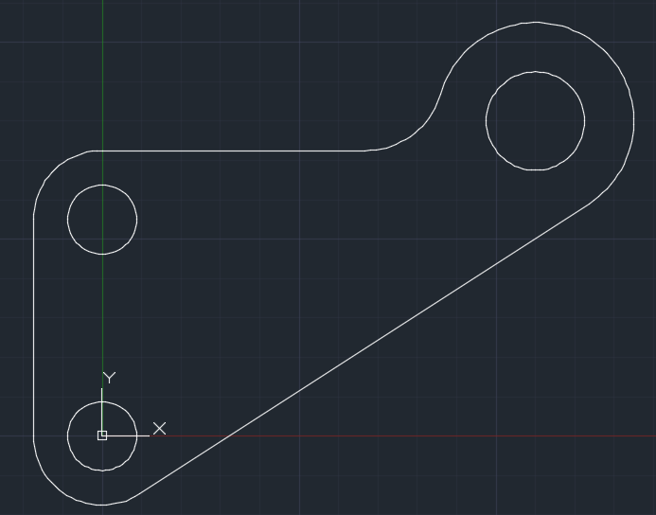
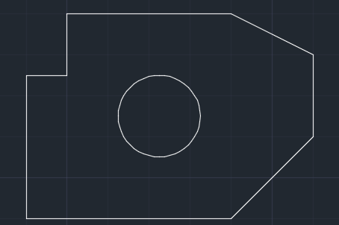
2D AutoCad

Slide 22
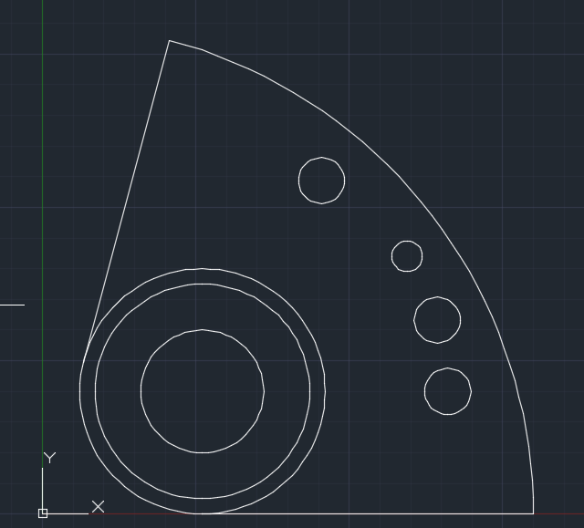
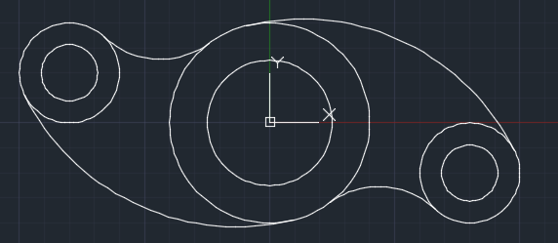
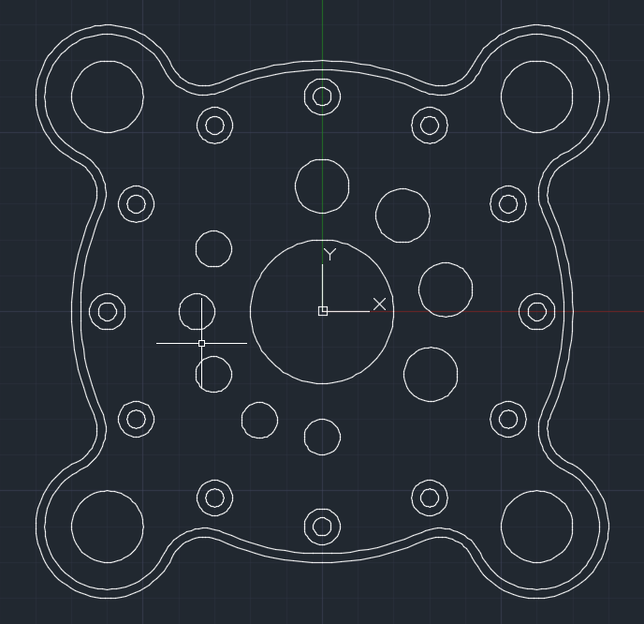
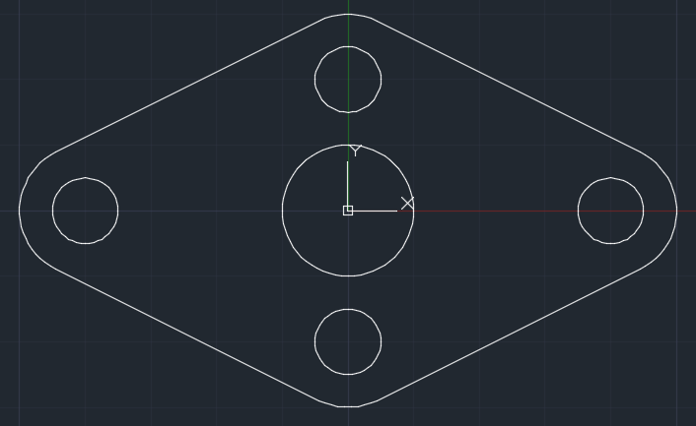
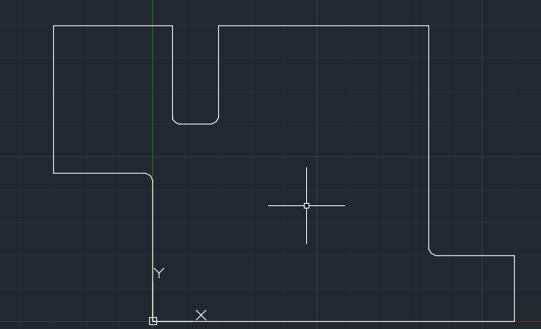
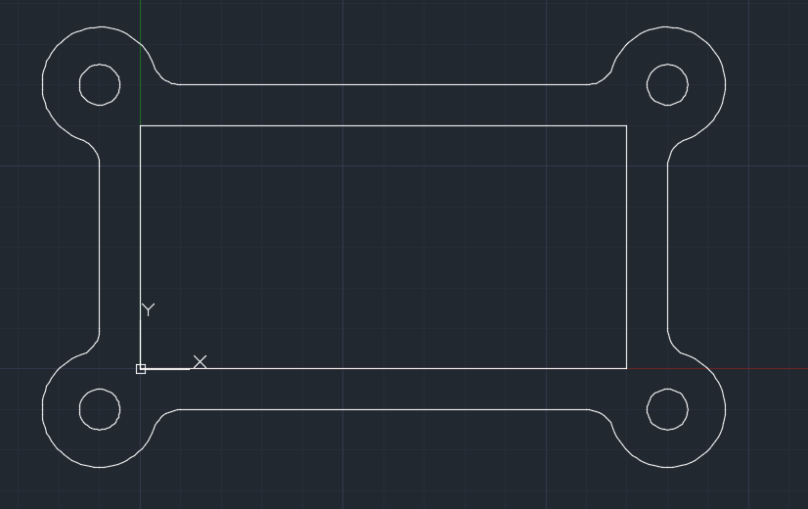
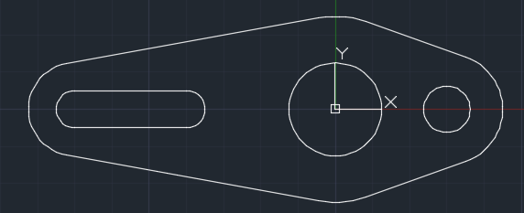
2D AutoCad

Slide 23
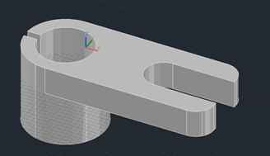
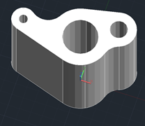
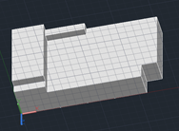
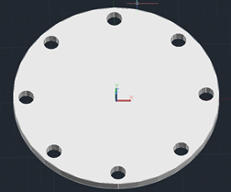
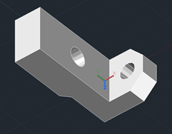
3D AutoCad

Slide 24

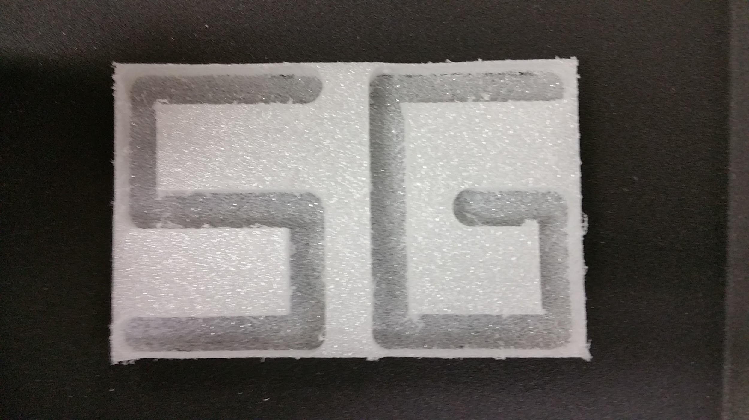
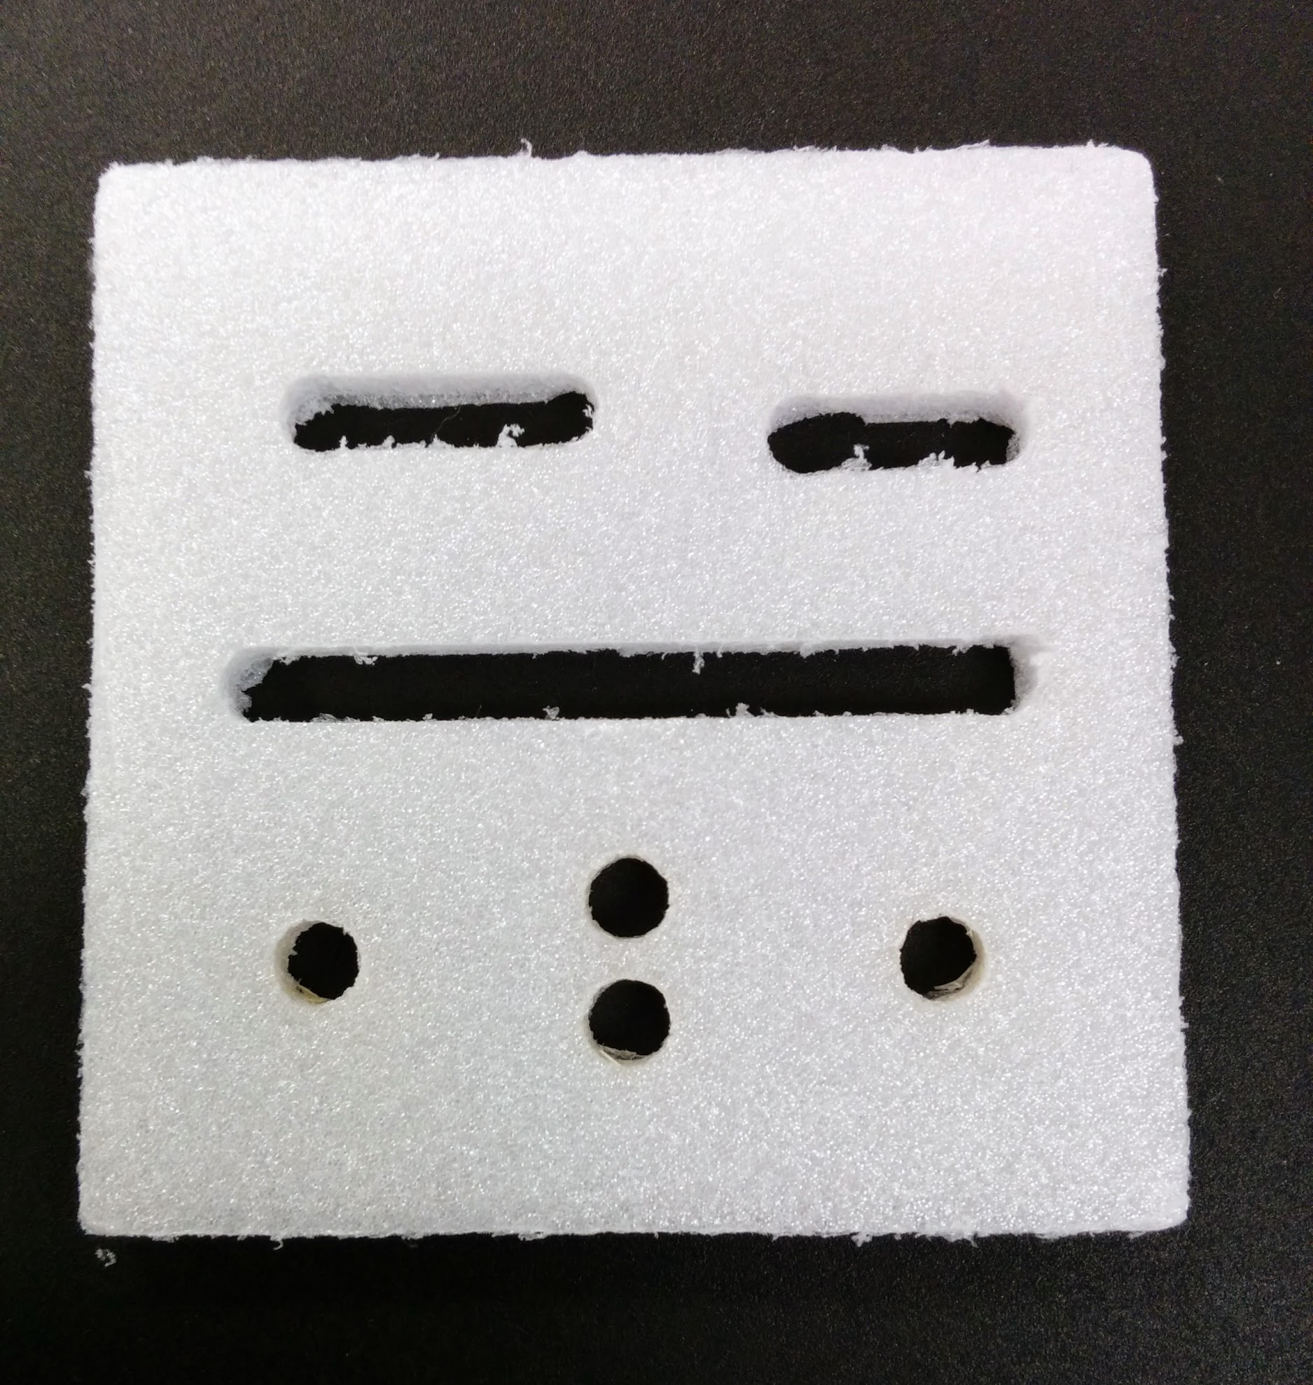
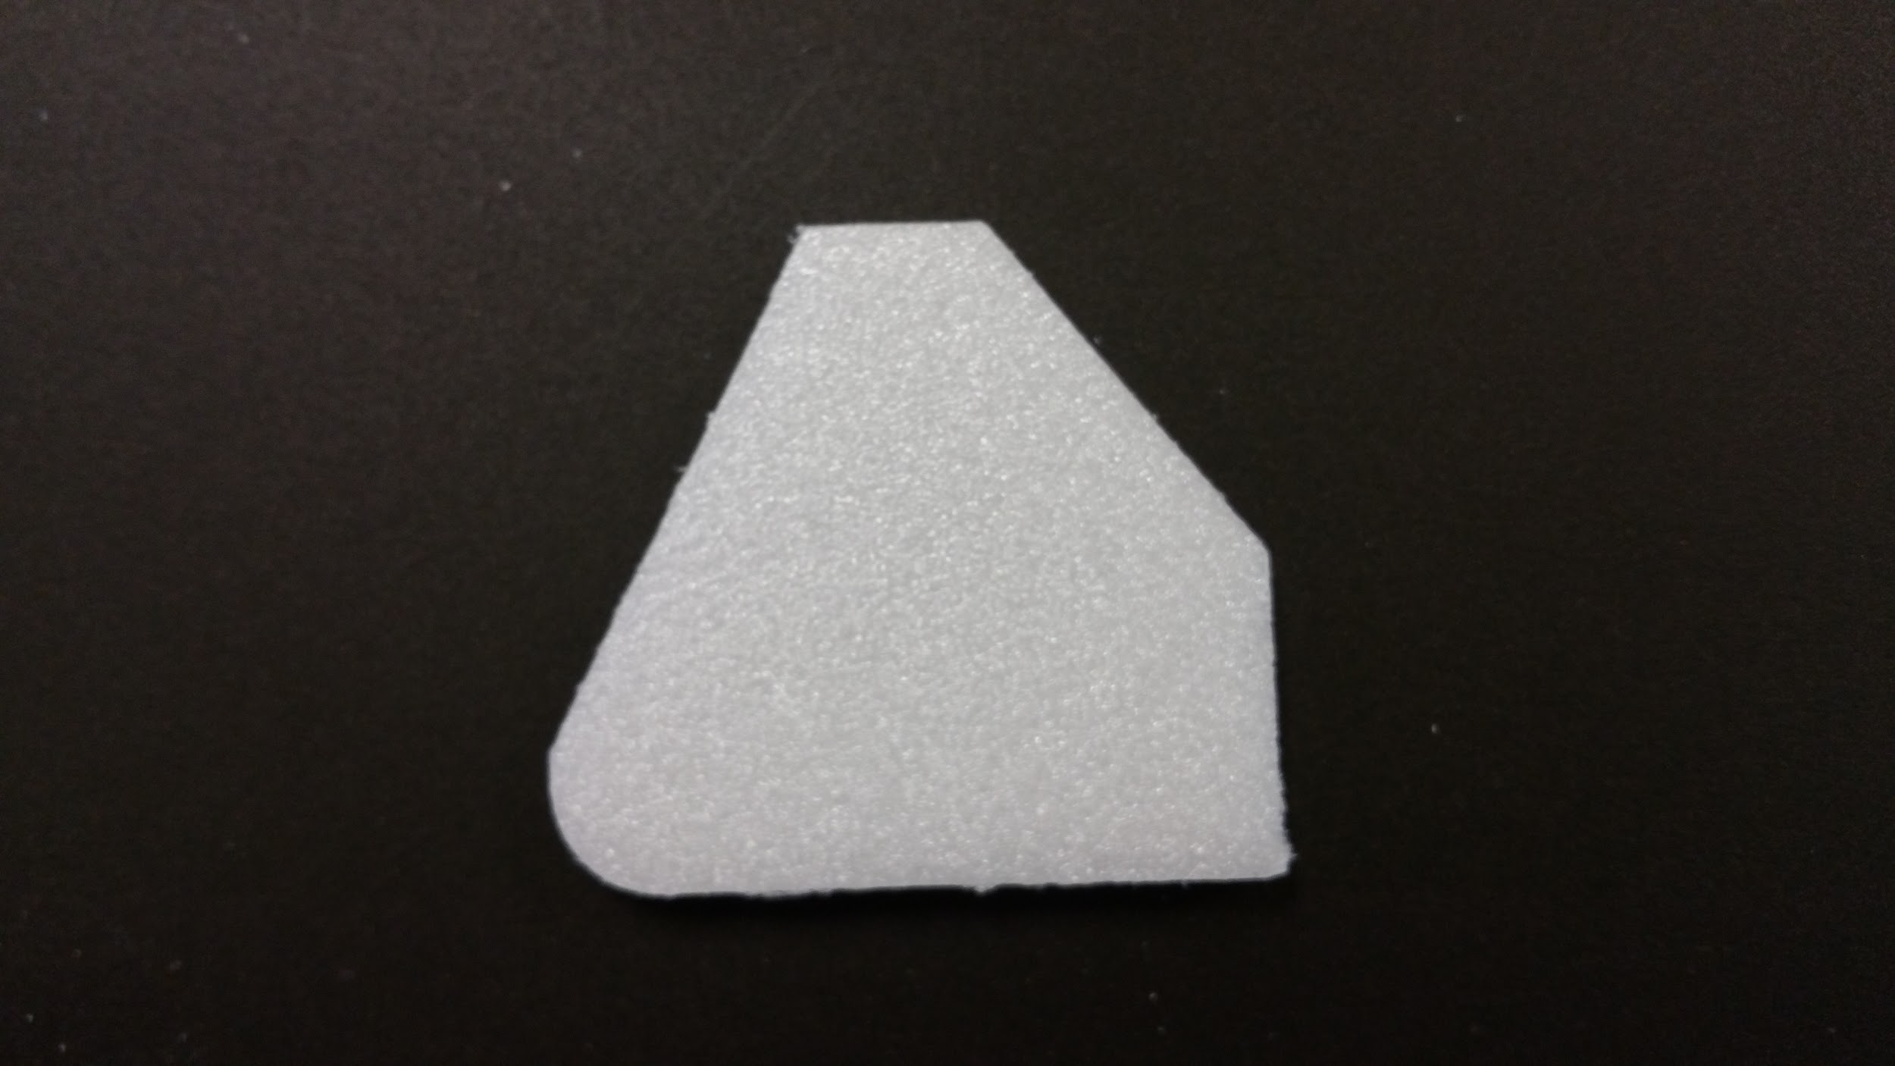
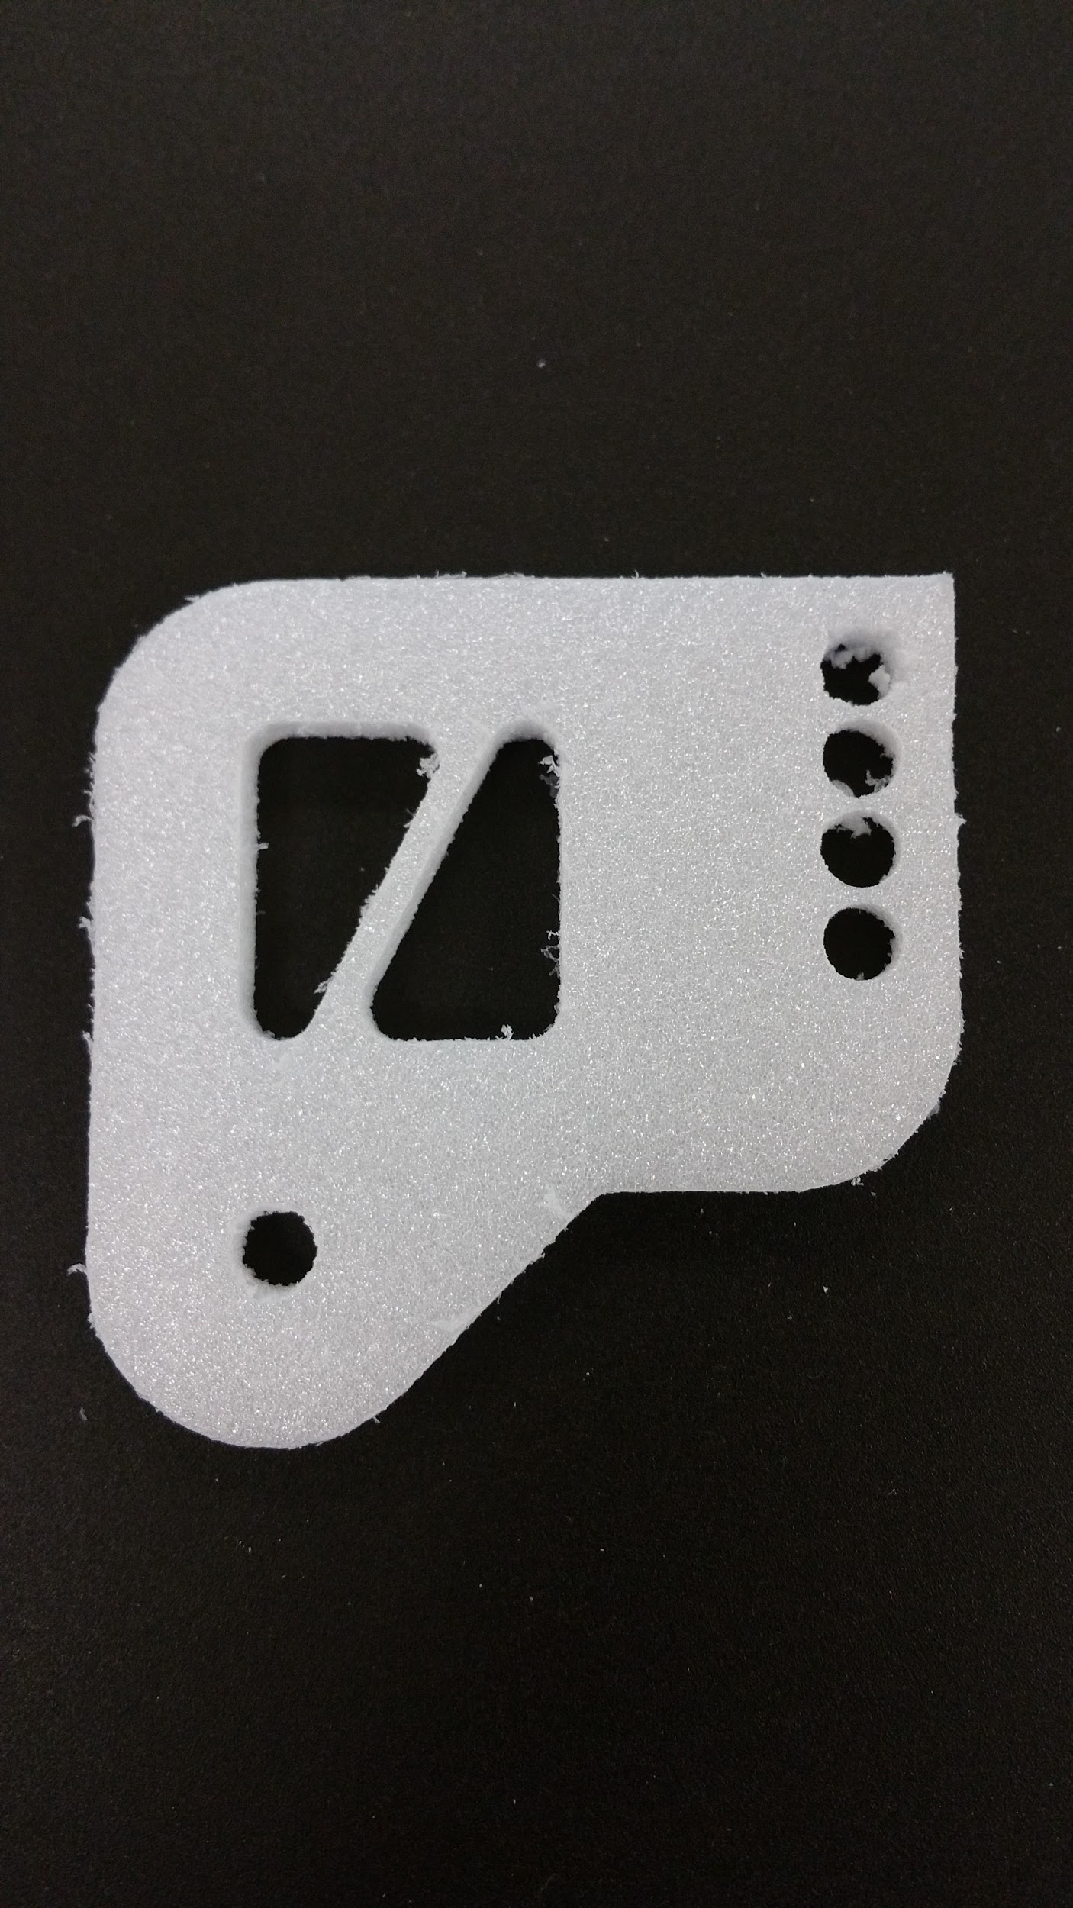
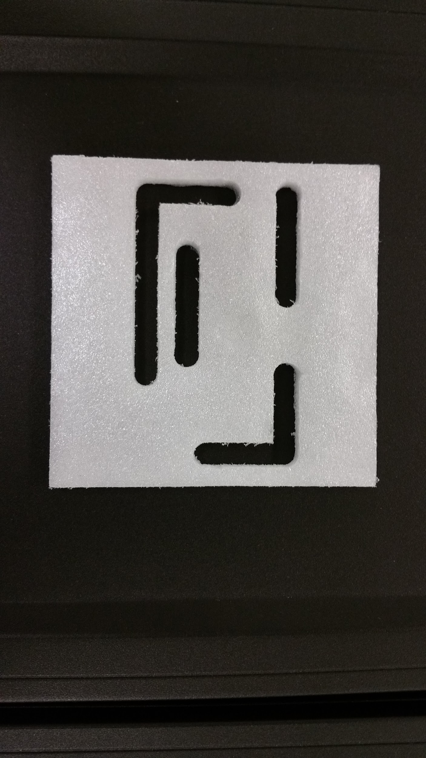
CNC Program

Slide 25
Extreme Redesign
Designed a USB and SD card holder
Holds up to 3 USB drives and 3 SD cards
Keeps USB’s and SD’s in a safe location

Slide 26
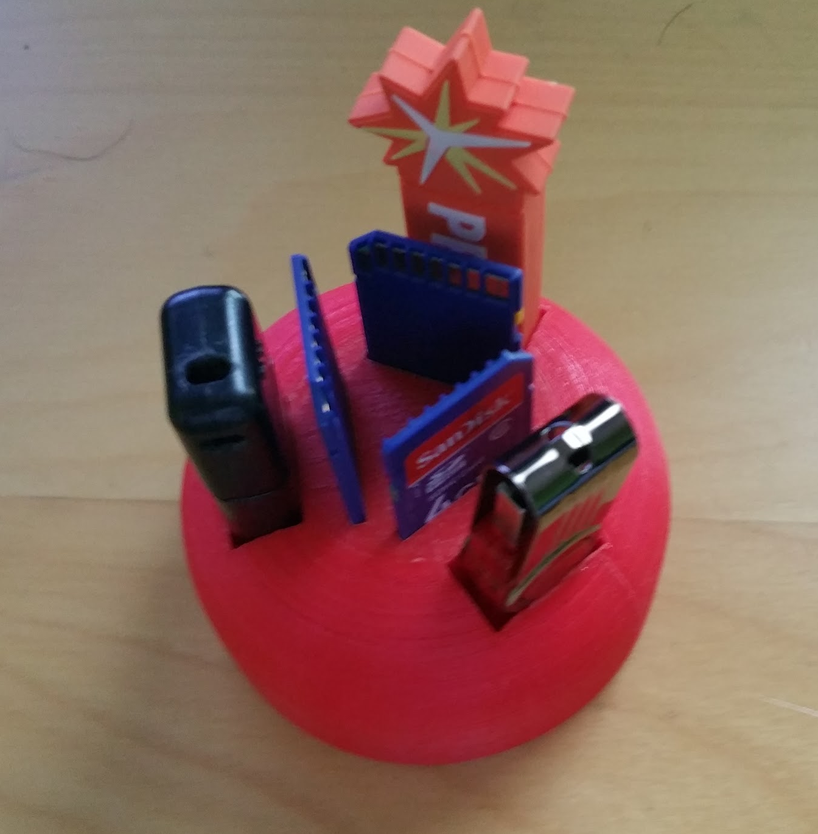

USB and SD card holder

Slide 27
Water Jet Cutter
Learned how to use FlowCut
Learned how to use FlowPath
Learned how to use the water jet
Designed my initials in AutoDesk Inventor

Slide 28



Water Jet

Slide 29
Robotics Engineering
Branch of Electrical Engineering
Mechanical engineering, electrical engineering, and computer science
Design and construction of robots
Created automated machines that replace humans

Slide 30
High-density polyethylene (HDPE)
Polyethylene thermoplastic made from petroleum
Advantages
Lighter, cheaper, more corrosion proof, higher strength to weight, and easier to cut compared to metals
Disadvantages
Soft, easily worn, bends and flex, cannot tap
Made either by Ziegler-Natta or Phillips-type catalyst

Slide 31
Electrical Engineering
Designed and built a variety of circuits
Passive and Active Circuits
Arduino code

Slide 32


Electrical Engineering
Servo Control by potentiometer
Op Amp Temperature Sensor

Slide 33

Senior Capstone
Combination of Electrical Engineering, Manufacturing Engineering, and Computer Science
Robotics Engineering
Arduino Controlled Stair Climber

Slide 34

Extracurricular Project - BarBot
Hardware project at PennApps Winter 2015
Design and laser cut box
Servo motor to open lid
Arduino and Android
BarBot automatically lifts it cover using sonar data

